Slide 1
Predicting customer buying behaviour

Slide 2
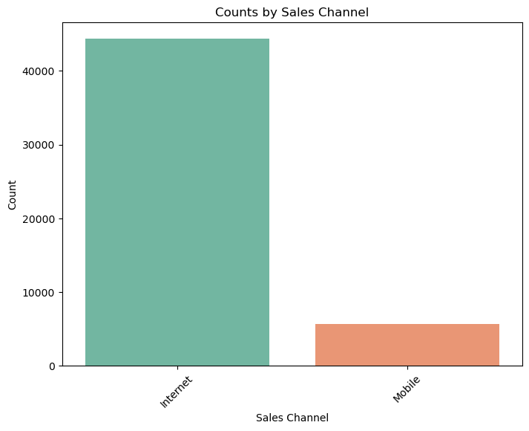
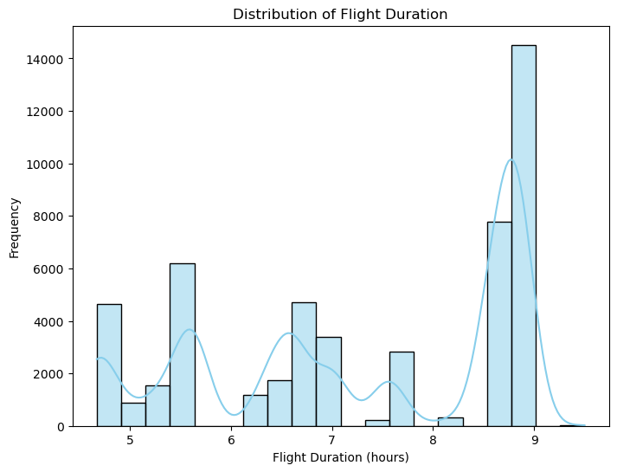
The Reason and the mode of booking

